Slide 1
Generics

Slide 2

Before Generics...
Compiler has no idea names can only store Strings.

Slide 3
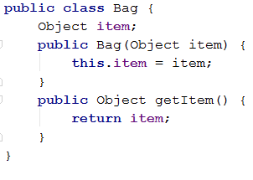



Another Example
Again, compiles fine
But fails at Runtime
ClassCastException: String cannot be cast to Integer

Slide 4
Goals
1. Provide compile time type safety
2. Eliminate the need for type casting

Slide 5
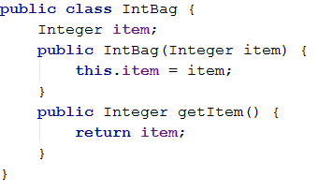
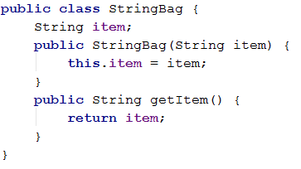
How? A Simple Idea...
What if you have a Bag for Integers and a Bag for Strings?

Slide 6



How? A Simple Idea...
Why is this BAD?

Slide 7
Generics
Until Java 1.4 => No Generics
In 2004, with Java 5.0 Generics was introduced
Key Ideas:
Parameterize type definitions
Provide type safety
Compiler performs type checking
Prevent runtime cast errors
Generics implement parametric polymorphism
Parametric: The type parameter (e.g., <E>)
Polymorphism: Can take many forms

Slide 8
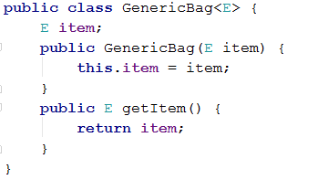
Example
E refers to a particular type
The constructor takes an object of type E, not any object
To use this class, E must be replaced with a specific class

Slide 9
Example
No more runtime errors

Slide 10
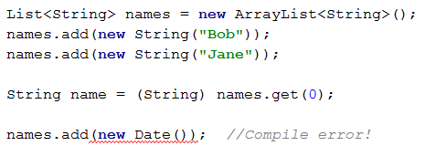
Example
Particularly useful for “container” classes
All collections classes in Java 5.0+ defined using generics

Slide 11
Generics Review
Key Ideas:
Parameterize type definitions
Provide type safety
Compiler performs type checking
Prevent runtime cast errors
Generics implement parametric polymorphism
Parametric: The type parameter (e.g., <E>)
Polymorphism: Can take many forms

Slide 12
Type Erasure
How are generics implemented?
It uses a technique called Type Erasure
Generic types only exist at the compiler level
Once compilation is done, the generic types are “erased” and the actual running code runs on type Object
Type information between angle brackets is thrown out
List<String> → List
Uses of type variables are replaced by Object
Casts are automatically inserted to preserve type correctness

Slide 13


From Last Time...
Specifying the type to store inside a list:

Slide 14
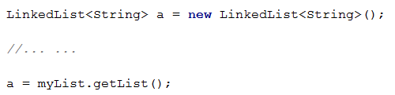
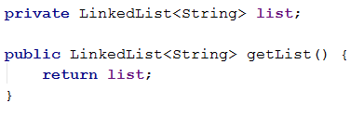
Programming to the interface
Provides flexibility
You don’t depend on a specific implementation of list
Easy to change later to some other implementation
What if I now want to use an ArrayList?

Slide 15
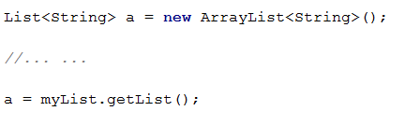
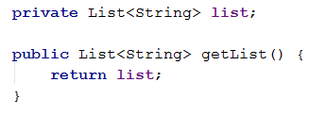
Programming to the interface
No longer tied to a specific implementation of List
Very minimal change to code if you decide to switch back to LinkedList

Slide 16
Advice on Generics
Always use them!
Valuable to ensure type safety
Provides abstraction
Reuse the same class with objects of many different types without creating multiple classes per type
Make a class Generic whenever possible
Use a variable T to represent the input type, and write your code to operate on objects of type T in a way that does not depend on the actual value of T.
Then instantiate the class many times, passing in different types for T.
T = Type
E = Element
K = Key (in a Map<K,V>)
V = Value

Slide 17



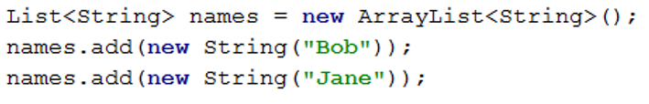
Old vs. New (Not really new, but you get the point)

